Slide 1
Image Processing
Clarity

Slide 2
Introduction
Visual Information transmitted in the form of digital images is a major method of communication in the modern age, but the image is often corrupted with noise.
The received image needs processing before it can be used in applications.
That is where we come in ;)
Image denoising involves the manipulation of the image data to produce a visually high quality image.

Slide 3
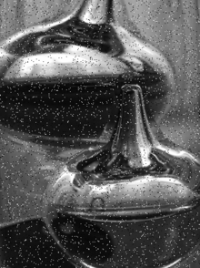
Noise Types:
Salt and Pepper noise
AKA: Intensity Spikes
Results in sparsely occurring white and black pixels
Hence, Salt and Pepper
Generally caused due to errors in data transmission

Slide 4
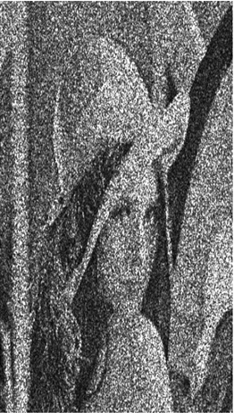
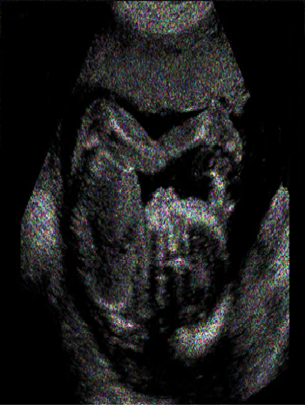
Speckle Noise
The vast majority of the image’s surface are extremely rough on the scale of the wavelength
Obtained from coherent imaging systems, such as :
Laser
Synthetic Aperture Radar (SAR)
Ultrasound imagery

Slide 5

Gaussian Noise
Clarity’s elected problem
Evenly distributed over the signal
Statistical noise, where the probability density function is equal to the normal distribution
i.e. Each pixel is the sum of the true pixel and a random Gaussian distributed noise value
So, how do we approach such a problem?

Slide 6
Technique (Gaussian Noise):
Spatial Domain Filtering: Applies a mean filter on an image to smoothen it, reduces intensity variation between adjacent pixels.
Implemented using a convolution matrix, weighted sum of the values of a pixel and its neighbors.

Slide 7

Process of a Convolution:
A convolution is done by multiplying a pixel and its neighboring pixels color values by a kernel.
A kernel is usually a small matrix of numbers that is used in image convolutions. (The size of a kernel is arbitrary)
Example of a kernel:
$\left[\begin{matrix}0 & 1 & 0 \\ 1 & 1 & 1 \\ 0 & 1 & 0\end{matrix}\right]$

Slide 8

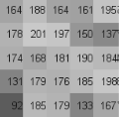
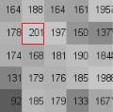
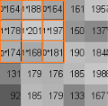



worked example…
$$V=\left\lceil \frac{\sum_{i=1}^{n}{\left(\sum_{j=1}^{n}{f_{ij}d_{ij}}\right)}}{F}\right\rceil$$
$$\left[\begin{matrix}164 & 188 & 164 \\ 178 & 201 & 197 \\ 174 & 168 & 181\end{matrix}\right]∗\left[\begin{matrix}0 & 1 & 0 \\ 1 & 1 & 1 \\ 0 & 1 & 0\end{matrix}\right]=\frac{932}{5}$$

Slide 9

Edge Extrapolation:
What to do when you process a pixel at a edge?
Need to extrapolate out from the edge.

Slide 10
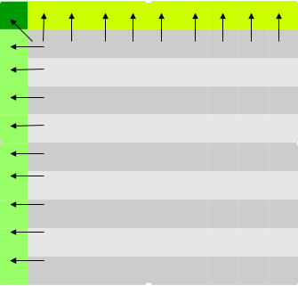
…
For Sides:
Copy value of vertical/horizontal neighbour
For Corners:
Copy value of vertical OR horizontal OR diagonal
neighbour.

Slide 11
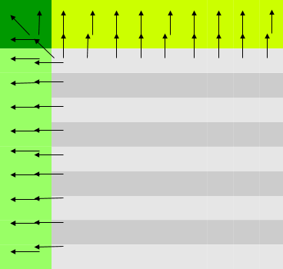
…
5x5 or larger convolution?
Simply apply this technique
recursively for the amount of
extension needed!

Slide 12

…
We do not need to process the kernel for an extended edge pixel
-> not part of final image.
Although we are using “false” picture
information, it is only a very small
percentage of the image.

Slide 13
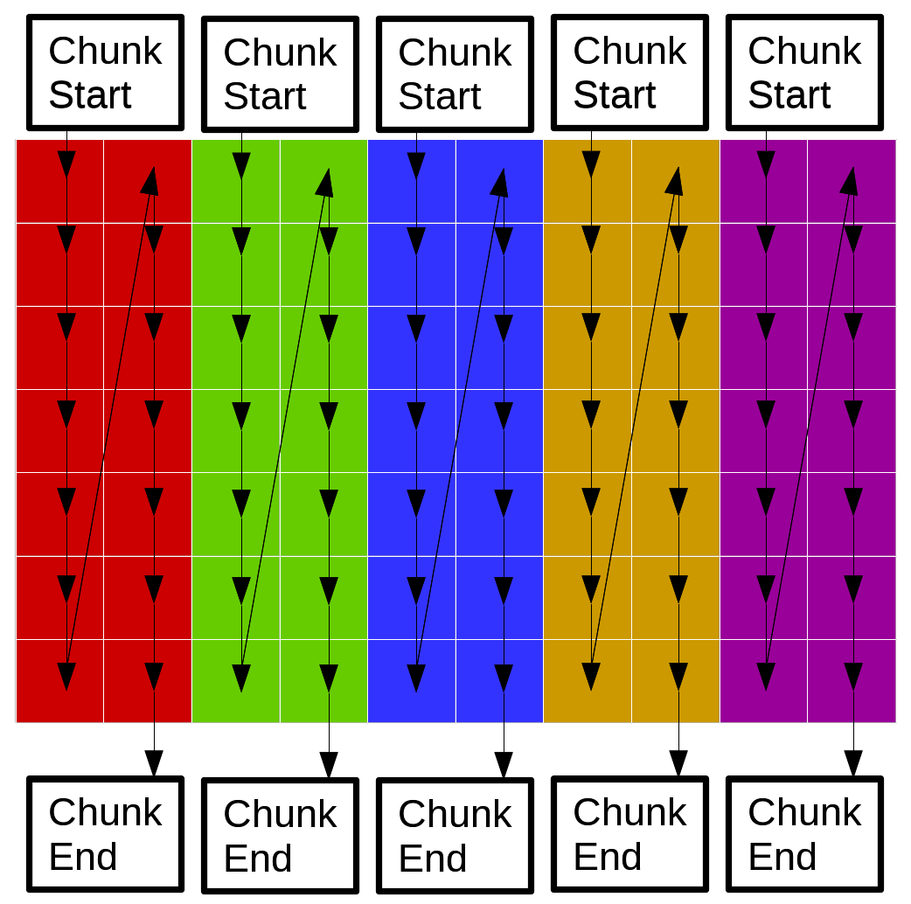
Parallel Implementation:
Instead of one thread doing the kernel for a single pixel at a time, we have several.
Let each thread handle one vertical “chunk” of the image. Converting Images into a matrix representation of their pixel color values. Both BW and RGB.
All threads use the same object
for reading pixels and the same
object for writing pixels.

Slide 14
Contention:
Chunks are width (matrix size)x2 --> threads work on pixels far away from each other.
Unlikely that the same pixel will be accessed by two threads at the same time.
They will access pixels on the same cache line (row) but effects of contention are minimal.
Tests on doing processing row wise or column wise reveal negligible difference. Thus contention due to the cache line is negligible.
Explanation: The image data structure stores pointers – contention on fetching pointers (size int) is a tiny part of actually modifying the pixel value the pointer points to. And once the pointer is fetched, contention will not arise for the rest of that pixel’s processing.
Thus it’s better not to split the source and output image into separate objects before doing the kernel (waste of time).

Slide 15
Results Analysis (Summary)

Slide 16
The Hardware:
Core i5 4670k
Quad Core
3.4 GHz (Overclocked)
Water Cooled

Slide 17
Results:
The following results were obtained by using a 5x5 Gaussian blur kernel matrix on the image set.
We should also note that the time taken to read from and write to files have been excluded.

Slide 18
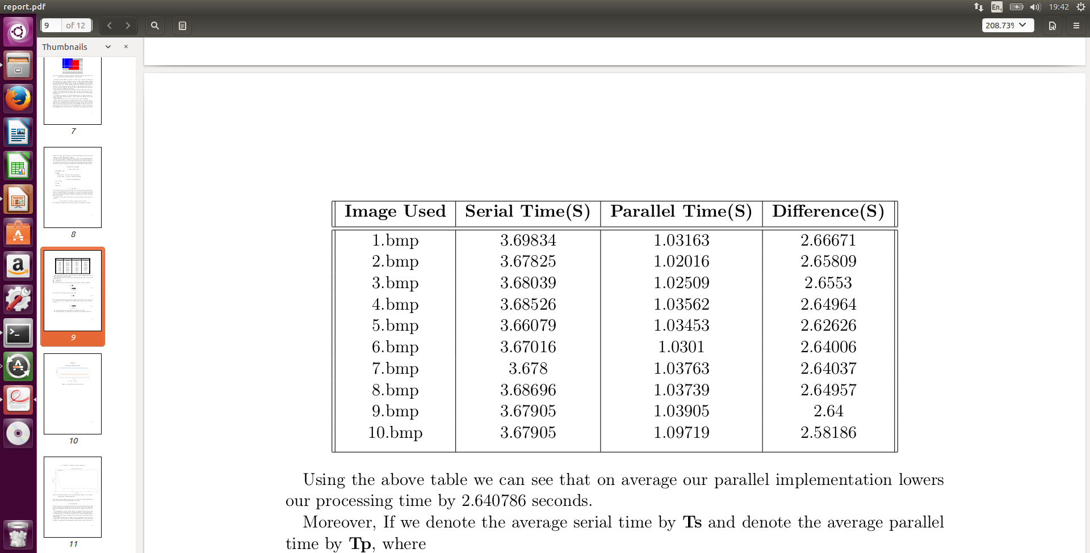
Serial vs. Parallel (4 threads):
Using the above table we can see that on average our parallel implementation lowers our processing time by 2.640786 seconds.

Slide 19
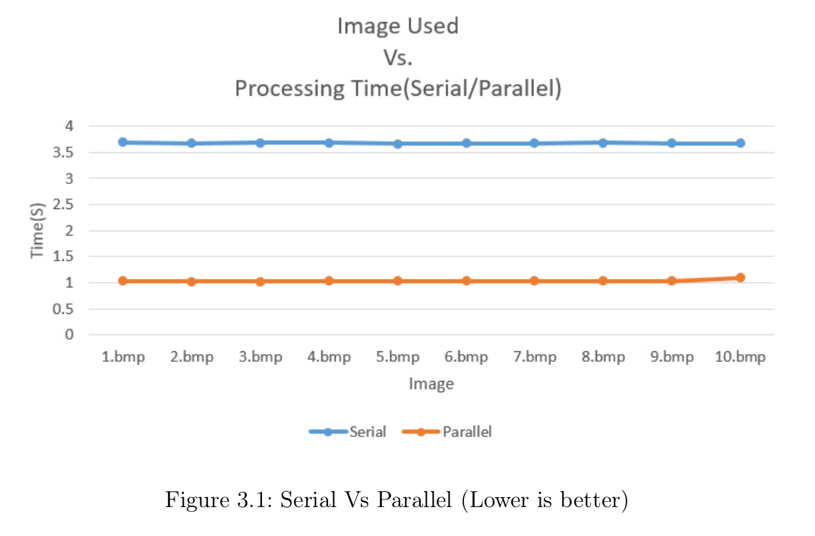
…
The above graph is just an illustration of the previous table.

Slide 20
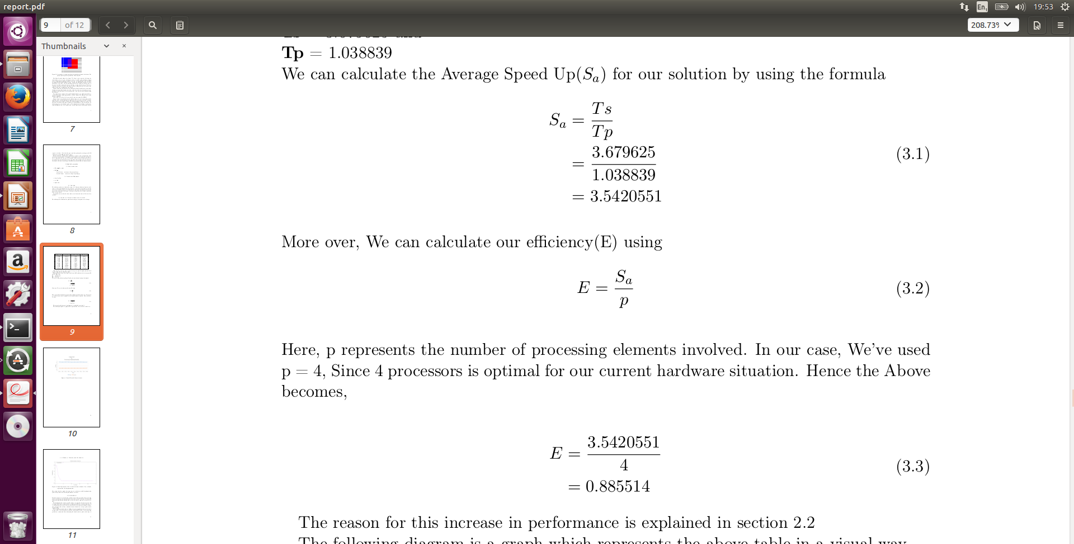
Performance metrics:
If we denote the average serial time by Ts and denote the average parallel time by Tp, where;
Ts = 3.679625 and Tp = 1.038839.
We calculate the Average Speed Up(Sa) for our solution:

Slide 21
…
More over, We can calculate our efficiency(E)
Note: Here, p represents the number of processing elements involved. In our case, We’ve used p = 4, Since 4 processors is optimal for our current hardware situation.

Slide 22
So what does this mean?
Our speed up tells us that our parallel implentation is on average around 3.5 times faster than our serial version.
And from our Efficiency we see that each of our 4 processing elements are usefully employed for around 88% of the time.

Slide 23
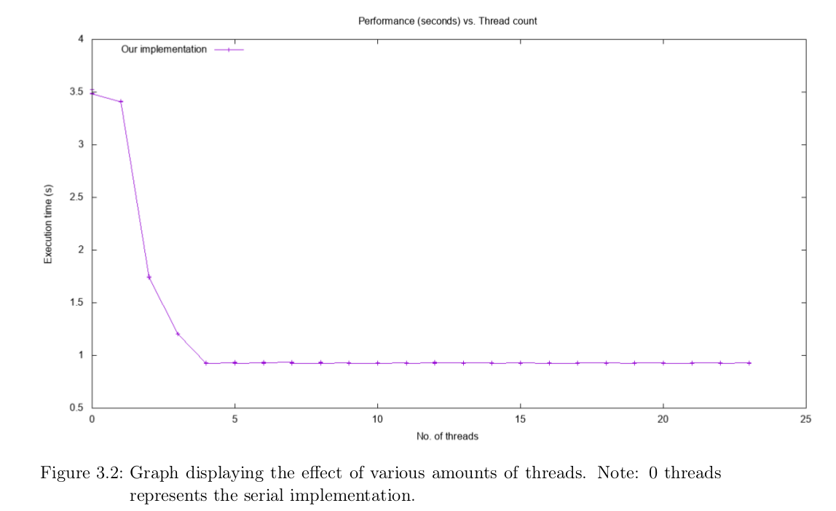
Serial vs. Parallel (with 1-23 threads):

Slide 24
…
In the previous graph the Test image was kept constant and the number of threads were varied.
It is interesting to note that after increasing the number of threads past 4(Optimal) the performance stays relatively constant.
Which makes sense in a Quad core environment.
It is for this reason that the bulk of the analysis was done by considering the 4 Threads as constant and Varying the Test images.

Slide 25
Conclusion

Slide 26
Conclusion/Wrap things up ??
Evidence from the analysis shows that the parallel version is indeed more efficient in comparison to the sequential version
From tests, there was no significant difference in the performance between accessing the 2D array row-wise vs column-wise
2D array stores pixel pointers, not actual pixel values
Results in minor idling
Problems
Inputting in terms of its pixel values
Resolved by EasyBMP
Multiplying pixels on the edges by the kernel matrix
Was dealt with Edge extrapolation
Finding the optimal kernel matrix
Each image is unique, Therefore different kernels for different images

Slide 27

Clarity… Bringing back the OG image, since 2016

